Slide 1
你好

Slide 2
Shivaji University, Kolhapur
Department of Statistics Seminar on
“Statistical Machine Translation”
Presented by
Sable Vinayak Machhindra MSc.II ASI Sem(III) Under the Guidance of Dr. S.B.Mahadik
2018-2019

Slide 3
Introduction
Machine Translation (MT) can be defined as the use of computers to automate some or all of the process of translating from one language to another.
MT is an area of applied research that draws ideas and techniques from linguistics, computer science, Artificial Intelligence (AI), translation theory, and statistics.
This seminar discusses the statistical approach to MT, which was first suggested by Warren Weaver in 1949 [Weaver, 1949], but has found practical relevance only in the last decade or so.

Slide 4
Approaches To MT
Rule Based Machine Translation Approach(RBMT)
Direct Machine Translation
Interlingua Machine Translation
Transfer-Based Machine Translation
Corpus-Based Machine Translation
Statistical Machine Translation
Example based Machine Translation(EBMT)
Hybrid Machine Translation

Slide 5
Corpus-Based Machine Translation
The approaches that we have seen so far, all use human-encoded linguistic knowledge to solve the translation problem.
We will now look at some approaches that do not explicitly use such knowledge, but instead use a training corpus ( plur . corpora ) of already translated texts — a parallel corpus — to guide the translation process.
A parallel corpus consists of two collections of documents: a source language collection, and a target language collection. Each document in the target language collection has an identified counterpart in the source language collection.

Slide 6
Statistical Machine Translation
Statistical MT models take the view that every sentence in the target language is a translation of the source language sentence with some probability.
The best translation, of course, is the sentence that has the highest probability.
The key problems in statistical MT are: estimating the probability of a translation, and efficiently finding the sentence with the highest probability.

Slide 7
Statistical Machine Translation:
An Overview
Every sentence in one language is a possible translation of any sentence in the other.
Assign to every pair of sentences (T,S) a probability, Pr(S|T), to be interpreted as the probability that a translator will produce S in the source language when presented with T in the target language
Pr(S|T) to be very small for pairs like ( Lematin je me brosse les dents | President Lincoln was a good lawyer)
And relatively large for pairs like (Le president Lincoln btait un bon avocat | President Lincoln was a good lawyer).
PROBLEM OF MACHINE TRANSLATION:
“Given a sentence S in the source language, we seek the sentence T from which the translator produced S.”
Chance of error is minimized by choosing that sentence T that is most probable given S. Thus, we wish to choose T so as to maximize Pr(T| S).

Slide 8


Statistical Machine Translation Model
The translation problem can be described as modelling the probability distribution P(T|S), where S is a string in the source language and T is a string in the target language.
Using Bayes’ Rule, this can be rewritten
[The denominator on the right of this equation does not depend on T, and so it suffices to choose the T that maximizes the product Pr(T)Pr(S|T)]
Pr(S|T) is called the “translation model” (TM).
Pr(T) is called the “language model” (LM).
The LM should assign probability to sentences which are “good English”.
Statistical Machine Translation Model :

Slide 9
A Language Model and a Translation Model furnish a probability distribution over target-source sentence pairs (T,S). The joint probability P(T,S) of the pair (T,S) is the product of the probability Pr (T) computed by the language model and the conditional probability Pr (S I T) computed by the translation model. The parameters of these models are estimated automatically from a large database of target-source sentence pairs using a statistical algorithm which optimizes, in an appropriate sense, the fit between the models and the data.
T S
A Decoder performs the actual translation. Given a sentence S in the Source language, the decoder chooses a viable translation by selecting that sentence in the target language for which the probability Pr (T|S) is maximum.
S T
Language
Model
P(T)
Translation
Model
P(S|T)
Decoder

Slide 10
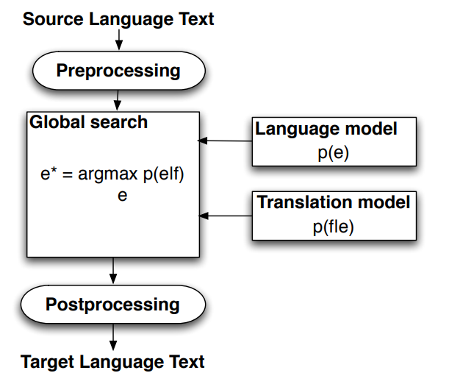
For People Who Don't Like Equations

Slide 11
Why not calculate P(T/S) directly...?
Why not calculate Pr ( T|S ) directly ,rather than break Pr (T |S ) into two terms,
Pr( T) and Pr (S|T), using Bayes’ rule.
Pr(S|T)Pr(T) decomposition allows us to be sloppy
Pr(T) worries about good English i.e the kind of sentences that are likely in language T.
Pr(T|S) worries about match with words i.e match of English word with French.
The two can be trained independently

Slide 12
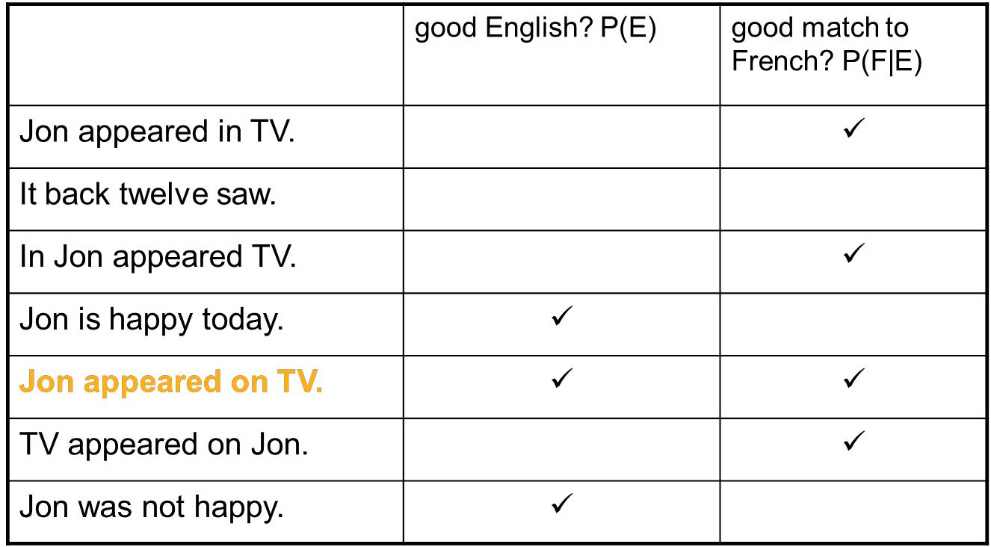
ON VOIT JON À LA TÉLÉVISION

Slide 13
LANGUAGE MODELLING
What’s P(T) ...?
Using The Chain Rule.
How do we calculate probabilities such as :
Because there are so many histories , we can not simply treat each of these probabilities as a separate parameter.
One way to reduce the number of parameters is to place each of the histories into an equivalence class in some way and then to allow the probability of an object word to depend on the history only through the equivalence class into which that history falls.
The choice of word T_{i} depends only on the n words before T_{i}

Slide 14


The n-gram approximation
In an N -gram model ,the probability of a word given all previous words is approximated by the probability of the word given the previous N -1 words.
The approximation thus works by putting all contexts that agree in the last N -1 words into one equivalence class.
With N = 2, we have what is called the bigram model, and N = 3 gives the trigram model.
Calculation:
N -gram probabilities can be computed in a straightforward manner from a corpus. For example, bigram probabilities can be calculated as:
Here count(w_{n-1} w_{n}) denotes the number of occurrences of the sequence w_{n-1} w_{n}. The denominator on the right hand side sums over all word w in the corpus — the number of times w_{n-1} occurs before any word.
Since this is just the count of w_{n-1}, we can write the above equation as,

Slide 15
EXAMPLE
For example, to calculate the probability of the sentence, “all men are equal”, we split it up as,
where start denotes the start of the sentence, and P( all| start) is the probability that a sentence starts with the word all.
Given the bigram probabilities in table,
The probability of the sentence is calculated as :
P ( all men are equal ) = 0 . 16 × 0 . 04 × 0 . 20 × 0 . 08 = 0 . 00028
Bigram | Probability
start all | 0.16
all men | 0.09
men are | 0.24
are equal | 0.08

Slide 16
TRANSLATION MODELLING
So, we’ve got P(T), let’s talk P(S|T)
For simple sentences, it is reasonable to think of the French translation of an English sentence as being generated from the English sentence word by word.
Thus, in the sentence pair (Jean aime Marie | John loves Mary) we feel that John produces Jean, loves produces aime , and Mary produces Marie . We say that a word is aligned with the word that it produces.
Not all pairs of sentences are as simple as this example. In the pair (Jean n'aime personne | john loves nobody), we can again align John with Jean and loves with aime , but now, nobody aligns with both n' and personne.
Sometimes, words in the English sentence of the pair align with nothing in the French sentence, and similarly, occasionally words in the French member of the pair do not appear to go with any of the words in the English sentence.
An alignment indicates the origin in the English sentence of each of the words in the French sentence.
The number of French words that an English word produces in a given alignment its fertility in that alignment.
Sometimes, a French word will appear quite far from the English word that produced it. We call this effect distortion.
Distortions will, for example, allow adjectives to precede the nouns that they modify in English but to follow them in French

Slide 17
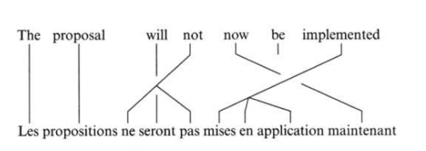
The Translation Model: P(T|S)
Alignment model:
assume there is a transfer relationship between source and target words
not necessarily one-to-one
Example
T = w₁ w₂ w₃ w₄ w₅ w₆ w₇
S = u₁ u₂ u₃ u₄ u₅ u₆ u₇ u₈ u₉
w₄=u₃ u₅
fertility of w₄ = 2
distortion w₅ = u₉

Slide 18
How to compute probability of an alignment?
Need to estimate
Fertility probabilities
P(fertility=n|w) = probability word w has fertility n
Distortion probabilities
P(i|j,l) = probability source word is at position i given target word at position j and l is the length of the source
Example
(Le chien est battu par Jean | John(6) does beat(3,4) the(1) dog(2))
P(f=1| John )P( Jean | John ) x
P(f=0| does ) x
P(f=2| beat )P( est | beat )P( battu | beat ) x
P(f=1| the )P( Le | the ) x
P(f=1| dog )P( chien | dog ) x
P(f=1|< null >)P( par |< null >) x distortion probabilities…

Slide 19
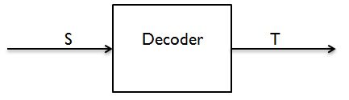
SEARCH/DECORDER
Not done yet
Given S
translation problem is to find T that maximizes P(T)P(S|T)
can’t look for all possible T in the language
Idea (Search):
construct best T incrementally
start with a highly likely word transfer
and find a valid alignment
extending candidate T at each step
(Jean aime Marie | * )
(Jean aime Marie | John(1) * )
Failure?
best T not a good translation
language model failed or
translation model failed
couldn’t find best T
search failure

Slide 20
PARAMETER ESTIMATION
Parameter Estimation
–English/French
from the Hansard corpus
– 100 million words
– bilingual Canadian parliamentary proceedings
– unaligned corpus
– Language Model
P(S) from bigram model
– Translation Model
how to estimate this with an unaligned corpus?
Used EM (Estimation and Maximization) algorithm, an iterative algorithm for re-estimating probabilities
Need
– P(u|w) for words u in S and w in T
– P(n|w) for fertility n and w in T
– P(i|j,l) for source position i and target position j and source length l

Slide 21
Systems Implementing Statistical Machine Translation
Google Translate
Microsoft Translator
Yandex.Translate

Slide 22
About Yandex.Translate
R Interface to Yandex Translate API. Yandex Translate is a statistical machine translation system. The system translates separate words, complete texts, and WebPages. This package can be used to detect language from text and to translate it to supported target language.
Here we have API key
For api_key click here

Slide 23
References:
Philipp Koehn and Chris Callison-Burch :Statistical Machine Translation
Peter E Brown,Vincent J. Della Pietra, Stephen A. Della Pietra,Robert L. Mercer :The Mathematics of Statistical Machine Translation: Parameter Estimation

Slide 24
Thank you......

